Slide 1
Calendar
Room 150 morning meeting

Slide 2
Starfall calendar: Click on picture to go to calendar

Slide 3
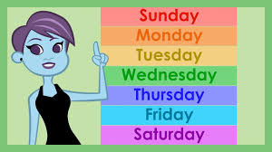
Days of the week:
Students can select the song by touching the picture.

Slide 4
Months:
Students can select the song by touching the picture.

Slide 5
Weather:
Students can select the song by touching the picture

Slide 6
Seasons
Students can select the song by touching the picture

Slide 7
Class favorites

